Slide 1


Sherri Nelson
September 29,2024

Slide 2

Outline
Executive Summary
Introduction
Methodology
Results
Conclusion
Appendix

Slide 3
Executive Summary
Data Collection: Collected data using SpaceX API and web scraping from Wikipedia​​.
Data Wrangling: Applied one-hot encoding for categorical features like booster version and handled missing values​.
Exploratory Data Analysis: Conducted EDA using SQL and data visualization to explore relationships between flight number, launch sites, payload mass, and orbit types​​.
Interactive Analytics: Created interactive visual analytics using Folium maps and Plotly Dash​​.
Predictive Analysis: Built and tuned machine learning models (Logistic Regression, Decision Tree, SVM) to predict landing success​.

Slide 4
Introduction
Context: SpaceX aims to reduce costs by reusing the first stage of the Falcon 9 rocket, which can drastically lower the price of space missions​.
Problem: Predicting whether the Falcon 9 first stage will land successfully based on factors such as payload mass, orbit, and booster version​.
Questions: What factors influence landing success?
How do various features interact to determine landing success?

Slide 5

Section 1

Slide 6
Methodology
Executive Summary
Data Collection:
Used SpaceX API to collect information on rocket launches​.
Web scraped Wikipedia to gather historical launch records​.
Data Wrangling:
Cleaned data and filled missing values.
Performed one-hot encoding for categorical data​​.
EDA:
Used SQL and Python to explore the dataset and identify key trends​​.
Interactive Visualizations:
Created interactive maps with Folium to display launch locations and success rates​.
Built a Plotly Dash dashboard to visualize the relationship between payload and success​.
Machine Learning:
Built classification models (Logistic Regression, Decision Trees) and used GridSearchCV for hyperparameter tuning​.

Slide 7
Data Collection
API Data: Collected launch details such as booster version, landing outcome, and payload mass using the SpaceX API​.
Web Scraping: Parsed HTML tables from Wikipedia to retrieve Falcon 9 launch records using BeautifulSoup​.

Slide 8
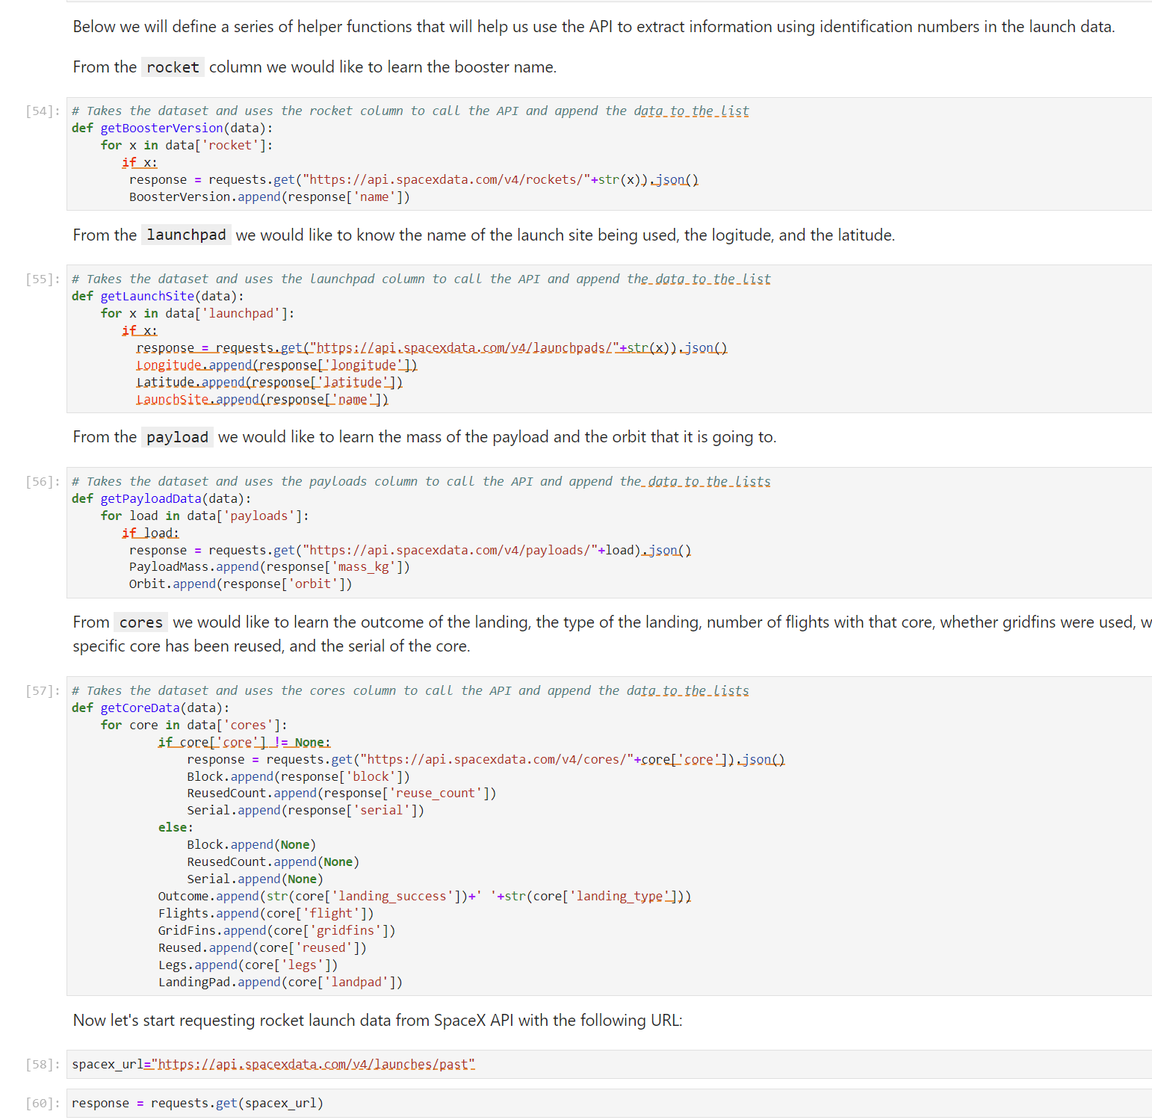
Data Collection – SpaceX API
Process:
Used Python’s requests library to fetch data from SpaceX API​.
Cleaned and converted data to pandas DataFrame for further analysis​.
Notebook Link: https://github.com/capponelson/Applied-Data-Science-Capstone/blob/main/Collecting%20Date%20Reboot.ipynb

Slide 9
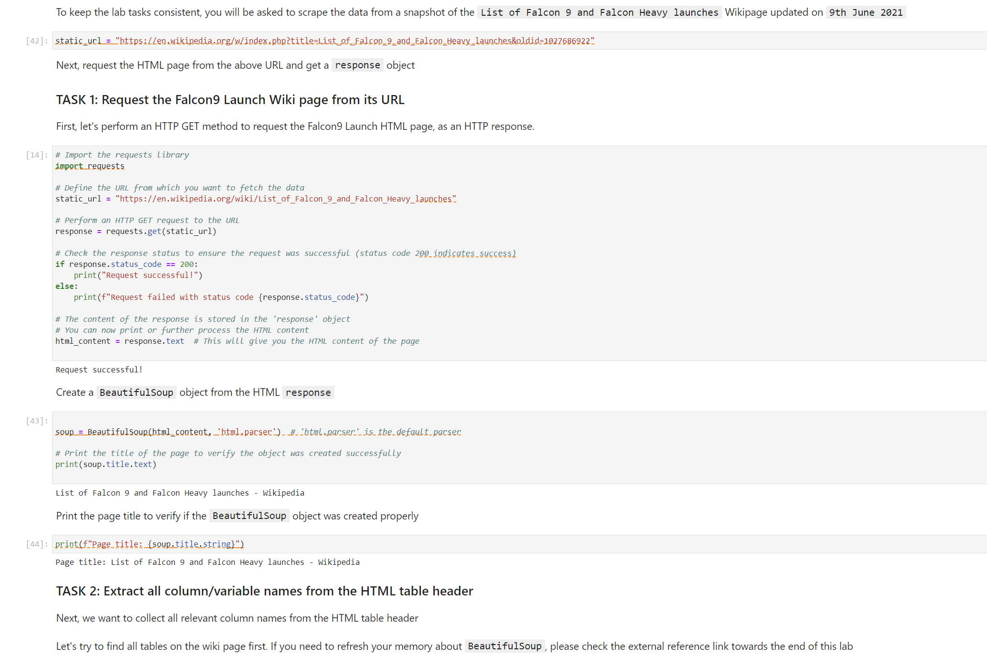
Data Collection - Scraping
Process:
Used BeautifulSoup to extract launch records from Wikipedia​.
Parsed HTML tables and converted them to DataFrame for analysis​.
Notebook Link: https://github.com/capponelson/Applied-Data-Science-Capstone/blob/main/Web%20scraping%20Falcon%209%20and%20Falcon%20Heavy.ipynb

Slide 10
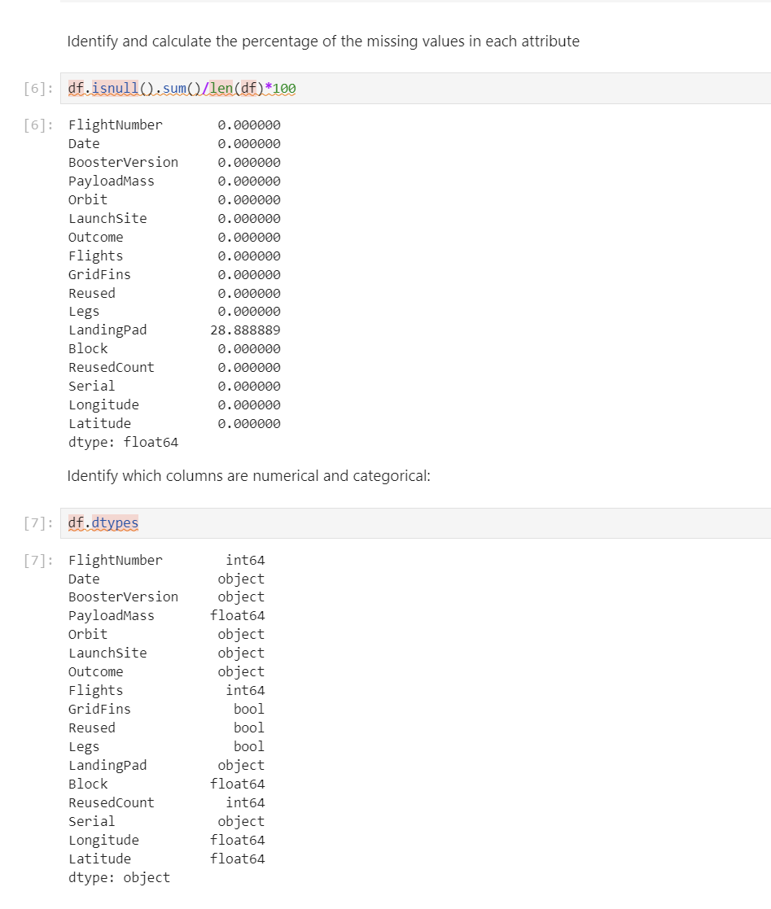
Data Wrangling
Process:
Cleaned the data by checking for missing values and applying transformations​.
Created the landing outcome column and exported results to CSV for further use​.
Notebook Link: https://github.com/capponelson/Applied-Data-Science-Capstone/blob/main/Data%20Wrangling.ipynb

Slide 11
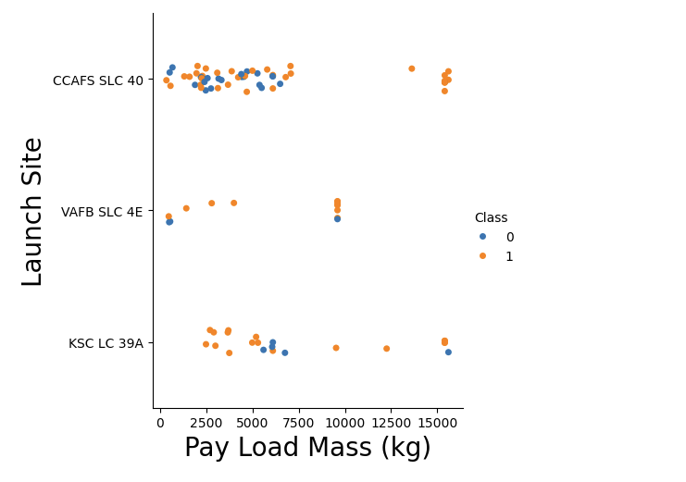
EDA with Data Visualization
Queries:
Found unique launch sites, calculated payload mass for different boosters, and identified mission outcomes​​.
Notebook Link: https://github.com/capponelson/Applied-Data-Science-Capstone/blob/main/EDA%20with%20Visualization.ipynb

Slide 12
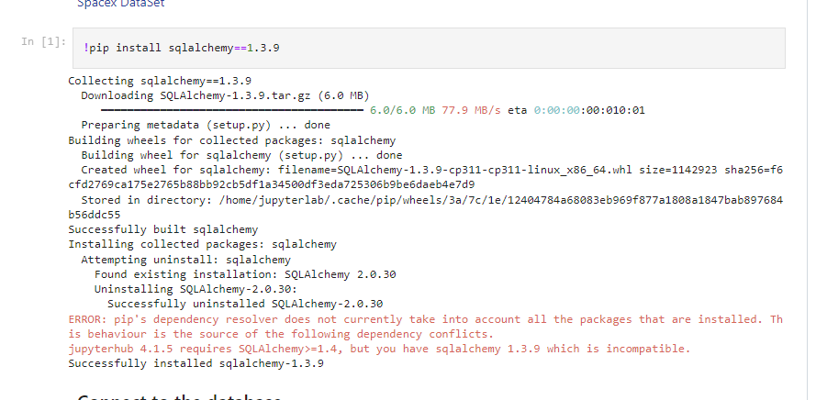
EDA with SQL
Queries:
Found unique launch sites, calculated payload mass for different boosters, and identified mission outcomes​​.
Notebook Link: https://github.com/capponelson/Applied-Data-Science-Capstone/blob/main/SQL%20Notebook%20for%20Peer%20Assignment.ipynb

Slide 13
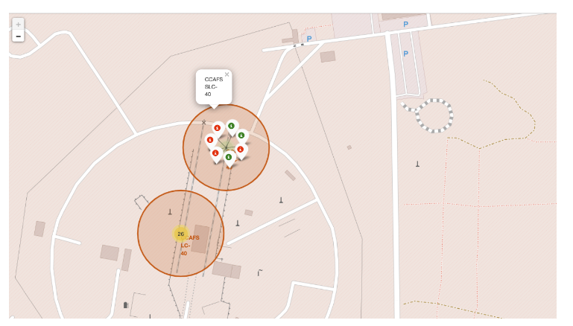
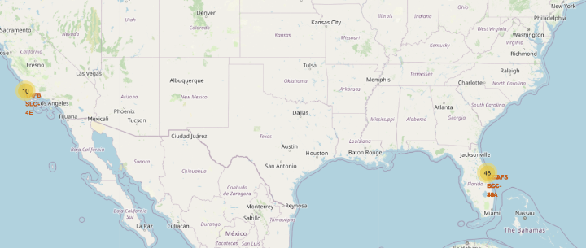
Build an Interactive Map with Folium
Process:
Mapped all launch sites and marked the success or failure of launches​.Analyzed launch site proximity to highways, railways, and cities​.
Create a `folium.PolyLine` object using the coastline coordinates and launch site coordinate
Create a marker with distance to a closest city, railway, highway relative to CCAFS SLC-40
Notebook Link: https://github.com/capponelson/Applied-Data-Science-Capstone/blob/main/Launch%20Sites%20Locations%20Analysis%20with%20Folium.ipynb

Slide 14
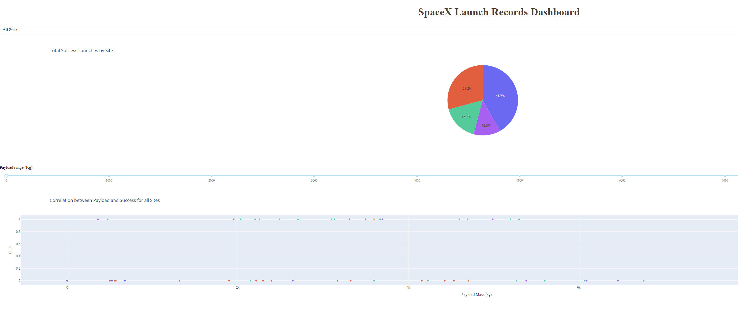
Build a Dashboard with Plotly Dash
Visuals:
Plotted success rates and payload vs. outcome relationships across launch sites​.
Notebook Link: https://github.com/capponelson/Applied-Data-Science-Capstone/blob/main/Dashboard%20with%20Plotly%20Dash.py

Slide 15
Predictive Analysis (Classification)
Process:
Built classification models to predict landing success, using GridSearchCV for tuning​.
Evaluated models based on accuracy and selected the best performing one​.
Notebook Link: https://github.com/capponelson/Applied-Data-Science-Capstone/blob/main/SpaceX_Machine%20Learning%20Prediction_Part_5.ipynb

Slide 16
Results
Key Findings:
Larger payloads are associated with lower success rates.
Certain orbits (e.g., LEO, GEO) have higher success rates​​.
The Decision Tree classifier had the highest accuracy for landing prediction​.

Slide 17

Section 2

Slide 18
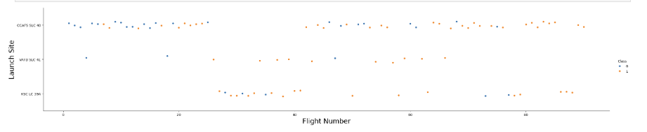
Flight Number vs. Launch Site
Show a scatter plot of Flight Number vs. Launch Site
Show the screenshot of the scatter plot with explanations
Flight Number vs. Launch Site shows a positive trend in landing success over time, particularly at the KSC LC-39A and CCAFS SLC-40 sites

Slide 19
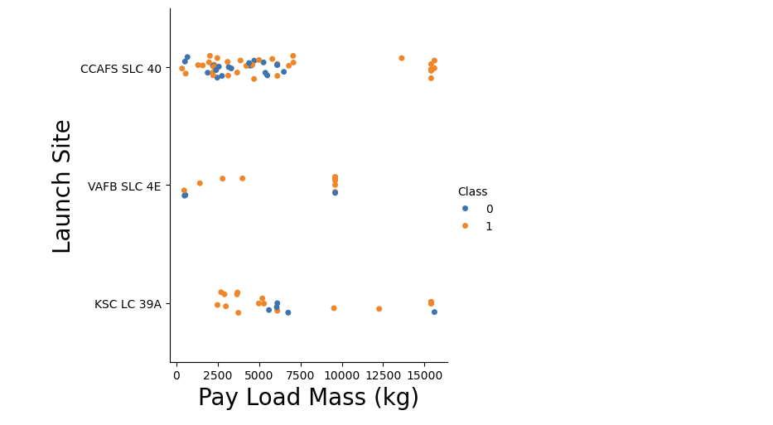
Payload vs. Launch Site
Show a scatter plot of Payload vs. Launch Site
Show the screenshot of the scatter plot with explanations
CCAFS SLC-40 is the most reliable site for launching heavy payloads, whereas KSC LC-39A excels with lighter and moderately heavy payloads.

Slide 20
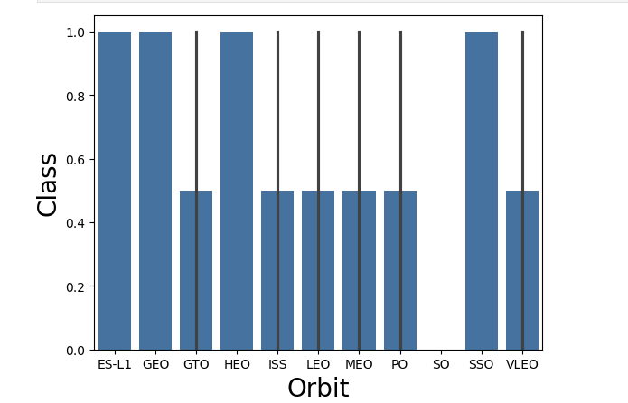
Success Rate vs. Orbit Type
Show a bar chart for the success rate of each orbit type
Show the screenshot of the scatter plot with explanations
Orbits such as ES-L1, GEO, HEO, PO, SO, and SSO have near-perfect success rates
GTO, LEO, and VLEO show lower success rates, suggesting that these orbits may involve more challenging landing condition

Slide 21
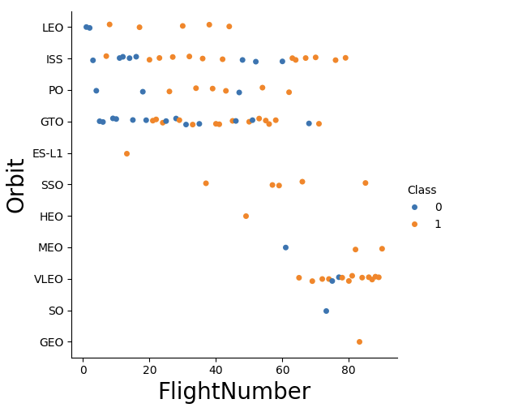
Flight Number vs. Orbit Type
Show a scatter point of Flight number vs. Orbit type
Show the screenshot of the scatter plot with explanations
In orbits such as LEO and ISS, SpaceX's success rate improves with higher flight numbers
GTO orbit seems to pose challenges, as success rates remain mixed across all flight numbers

Slide 22
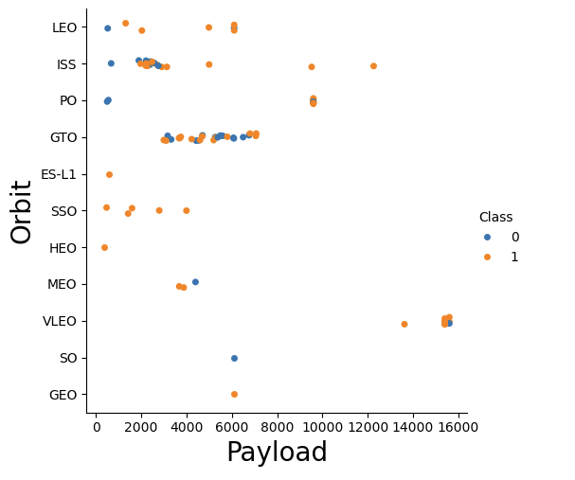
Payload vs. Orbit Type
Show a scatter point of payload vs. orbit type
Show the screenshot of the scatter plot with explanations
With heavy payloads, successful landing rates are higher for Polar, LEO, and ISS missions. However, for GTO missions, it is challenging to differentiate between successful and unsuccessful landings, as both outcomes are observed.

Slide 23
Launch Success Yearly Trend
Show a line chart of yearly average success rate
Show the screenshot of the scatter plot with explanations

Slide 24
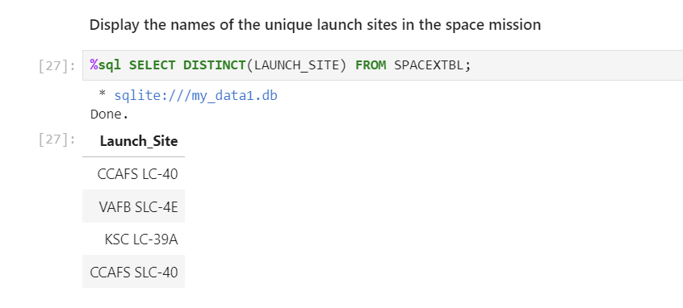
All Launch Site Names
Find the names of the unique launch sites
DISTINCT was used to show unique sites

Slide 25
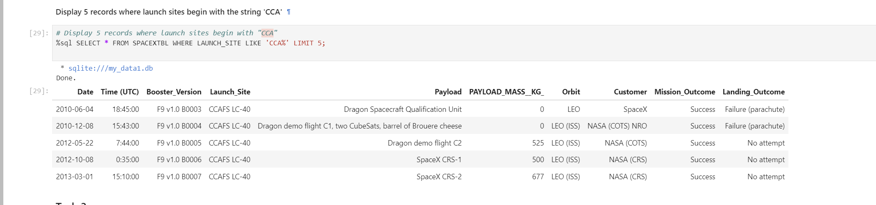
Launch Site Names Begin with 'CCA'
Find 5 records where launch sites begin with `CCA`
SQL query was used with a limit 5 to display 5 records

Slide 26
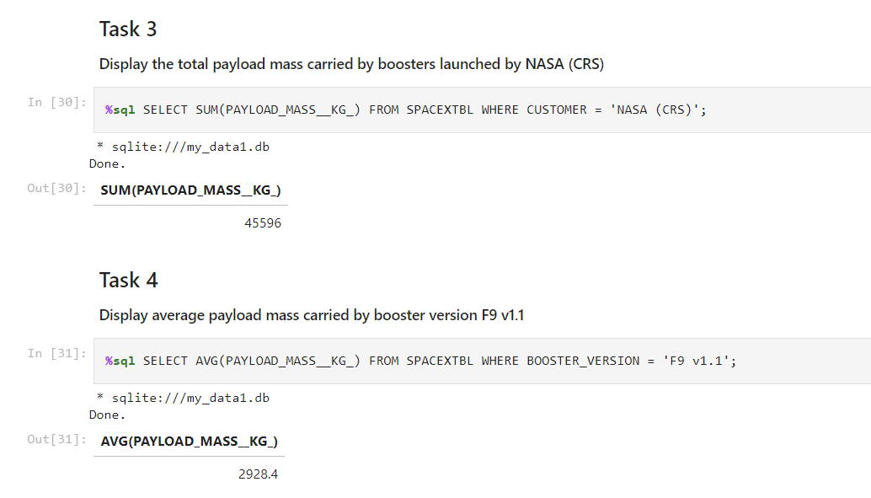
Total Payload Mass
Calculate the total payload carried by boosters from NASA
Total Payload and Average showed

Slide 27
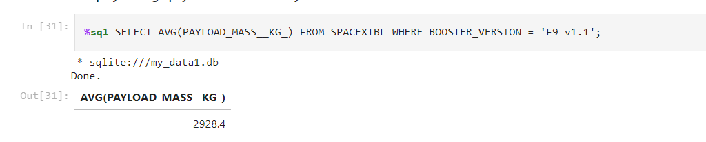
Average Payload Mass by F9 v1.1
Calculate the average payload mass carried by booster version F9 v1.1
Average Payload shown

Slide 28
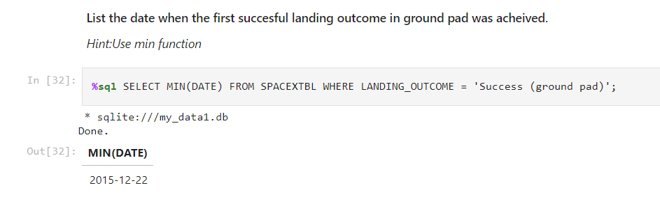
First Successful Ground Landing Date
Find the dates of the first successful landing outcome on ground pad
First successful landing in December 2015

Slide 29
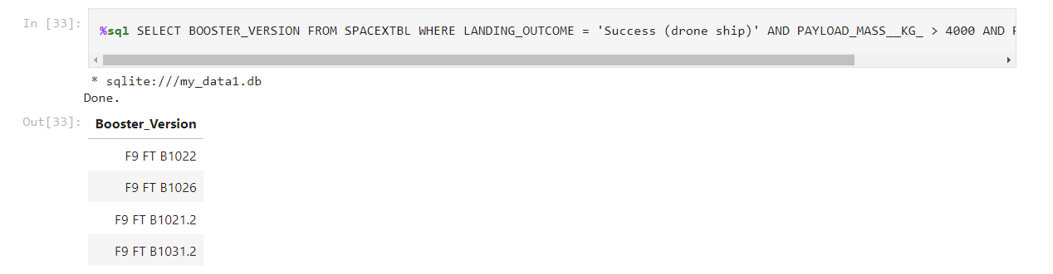
Successful Drone Ship Landing with Payload between 4000 and 6000
List the names of boosters which have successfully landed on drone ship and had payload mass greater than 4000 but less than 6000
Retrieves a list of booster versions that have successfully landed on a drone ship and carried a payload mass between 4000 kg and 6000 kg

Slide 30
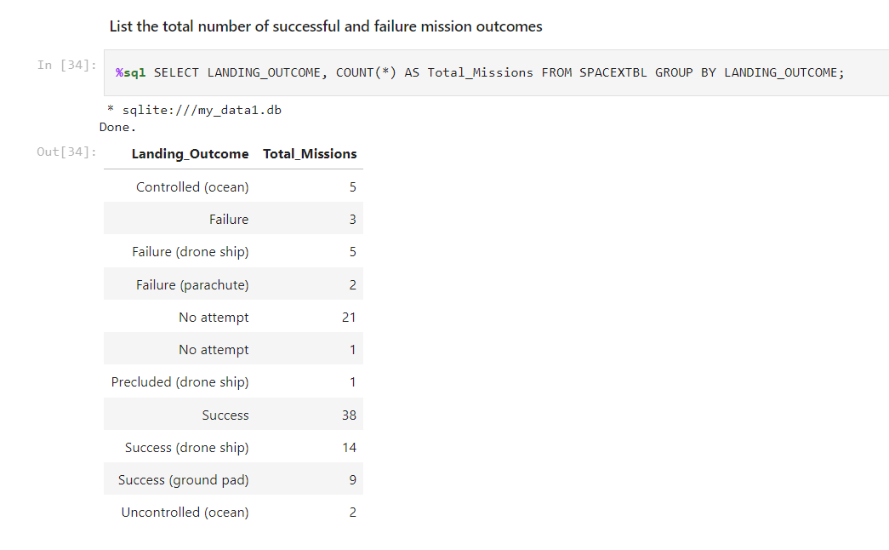
Total Number of Successful and Failure Mission Outcomes
Calculate the total number of successful and failure mission outcomes
There were 38 successful landings in total (without specifying where they landed), 14 of which were successful landings on drone ships, and 9 on ground pads. This shows that more than half of the missions had a successful recovery.

Slide 31
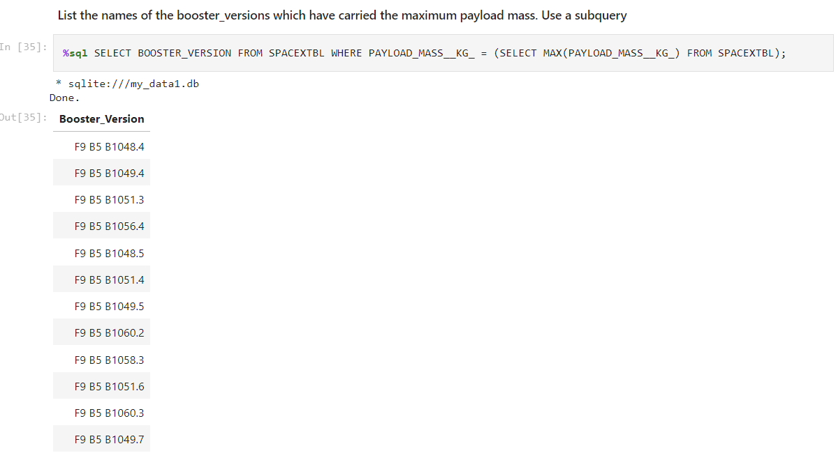
Boosters Carried Maximum Payload
List the names of the booster which have carried the maximum payload mass
The results show multiple boosters (e.g., F9 B5 B1048.4, F9 B5 B1049.4, etc.) that carried the maximum payload.
The booster version format (e.g., F9 B5 B1048.4) refers to SpaceX's Falcon 9 rocket (F9), Block 5 (B5), and the specific booster number (B1048.4).

Slide 32
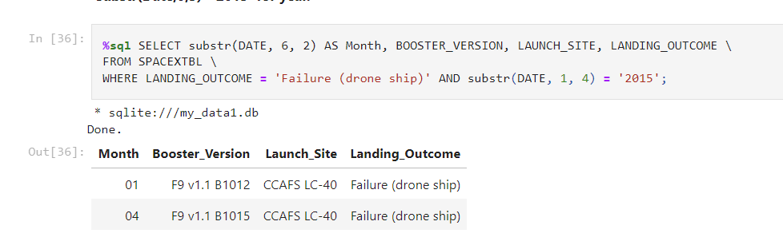
2015 Launch Records
List the failed landing_outcomes in drone ship, their booster versions, and launch site names for in year 2015
The query only includes records where the landing outcome was a "Failure (drone ship)"

Slide 33
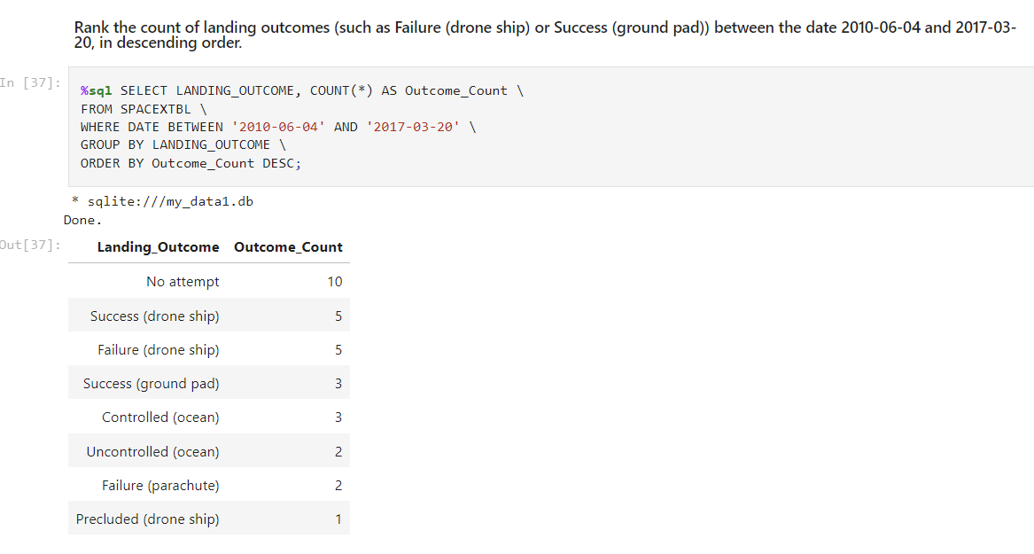
Rank Landing Outcomes Between 2010-06-04 and 2017-03-20
Rank the count of landing outcomes (such as Failure (drone ship) or Success (ground pad)) between the date 2010-06-04 and 2017-03-20, in descending order
"No attempt" is the most common outcome during this period, reflecting that SpaceX didn’t attempt to recover the booster for 10 missions.
The equal distribution of success and failure on drone ships (5 each) shows the early experimental nature of SpaceX’s attempts to land on drone ships.

Slide 34

Section 3

Slide 35
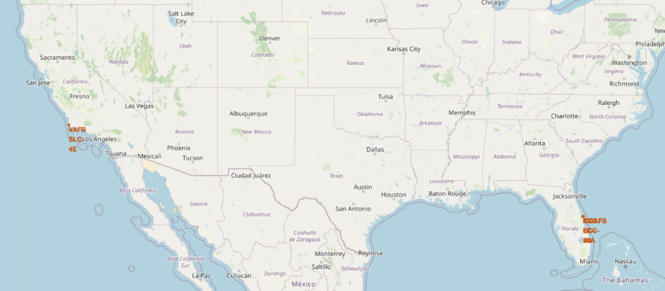
Location for Launch Sites
The Equator runs at 0° latitude, and none of the launch sites shown on the map are near this line. The United States is far north of the Equator, with the closest launch sites being located in Florida, which is still around 28° latitude north of the Equator.
launch sites are located very close to the coast.

Slide 36
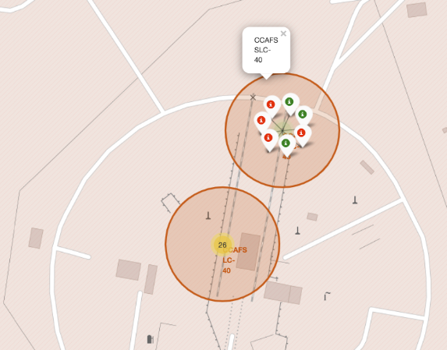
Markers showing sites (Color coded)
Green – Successful Launches
Red – Failed Launches

Slide 37
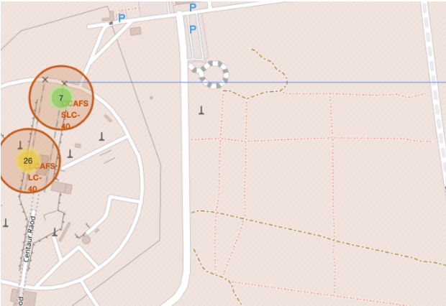

Launch Site Proximity
SpaceX launch site (LC-40 at Cape Canaveral Air Force Station) with a distance line indicating a distance of 0.90 km to a certain feature on the map
Railway and highway map symbols to indicate nearby transportation infrastructure.

Slide 38

Section 4

Slide 39
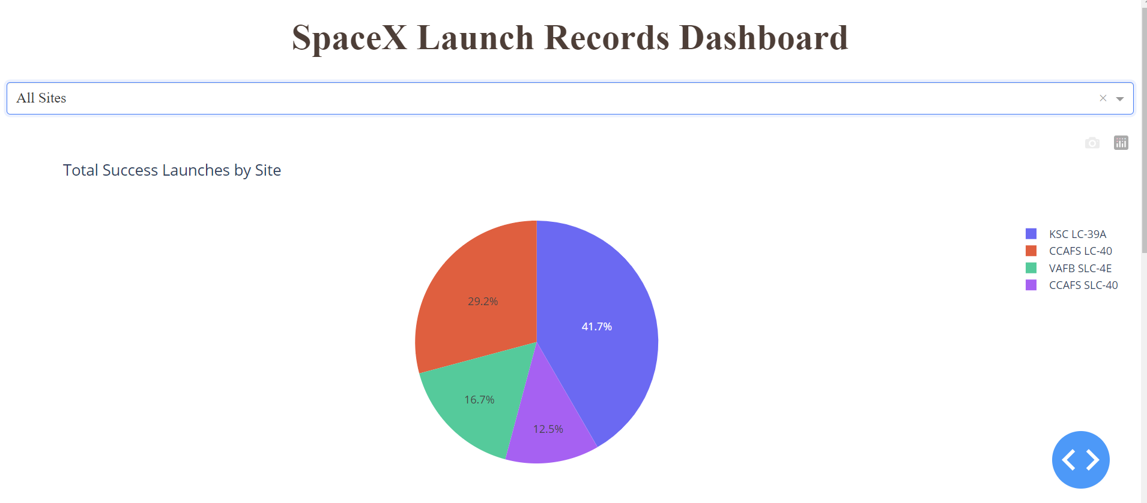
Total Success of Launches by Site
KSC LC-39A had the most successful launches from all the sites.

Slide 40
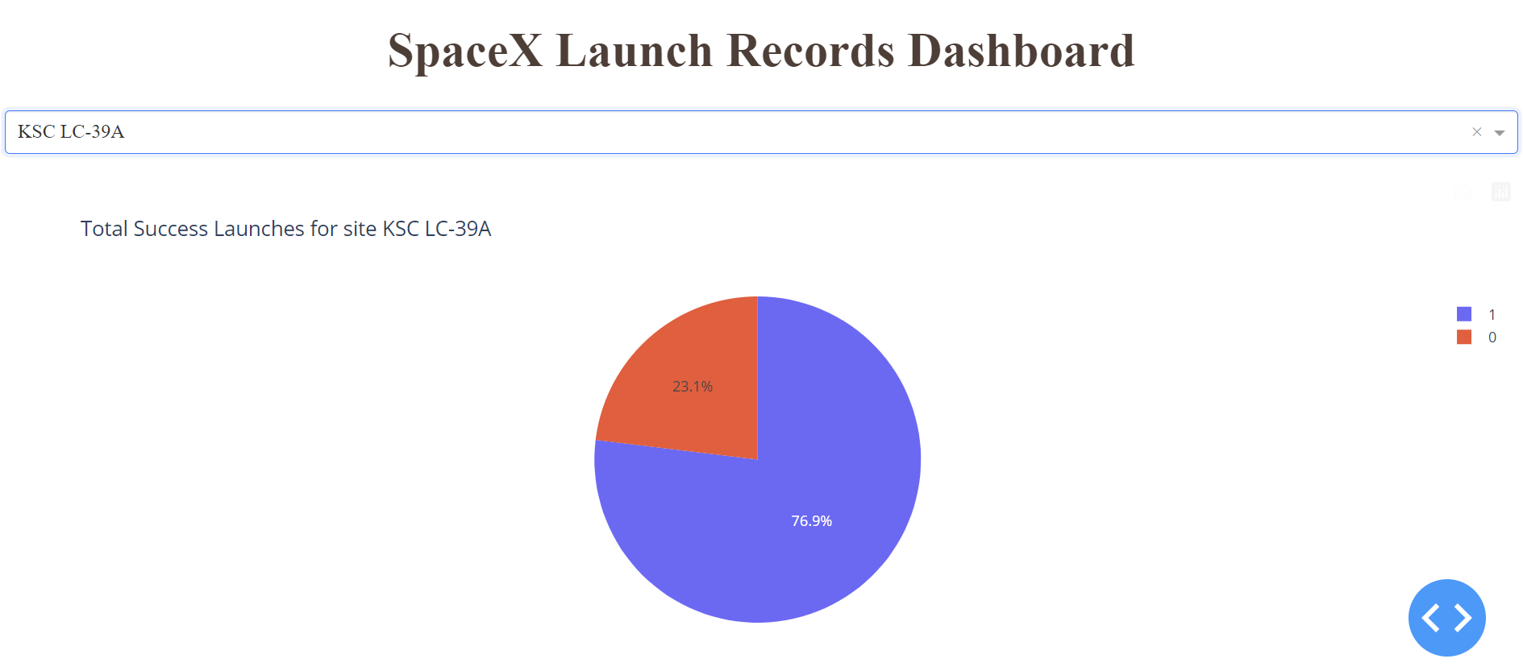
Piechart for the launch site with highest launch success ratio
Piechart for the launch site with highest launch success ratio

Slide 41
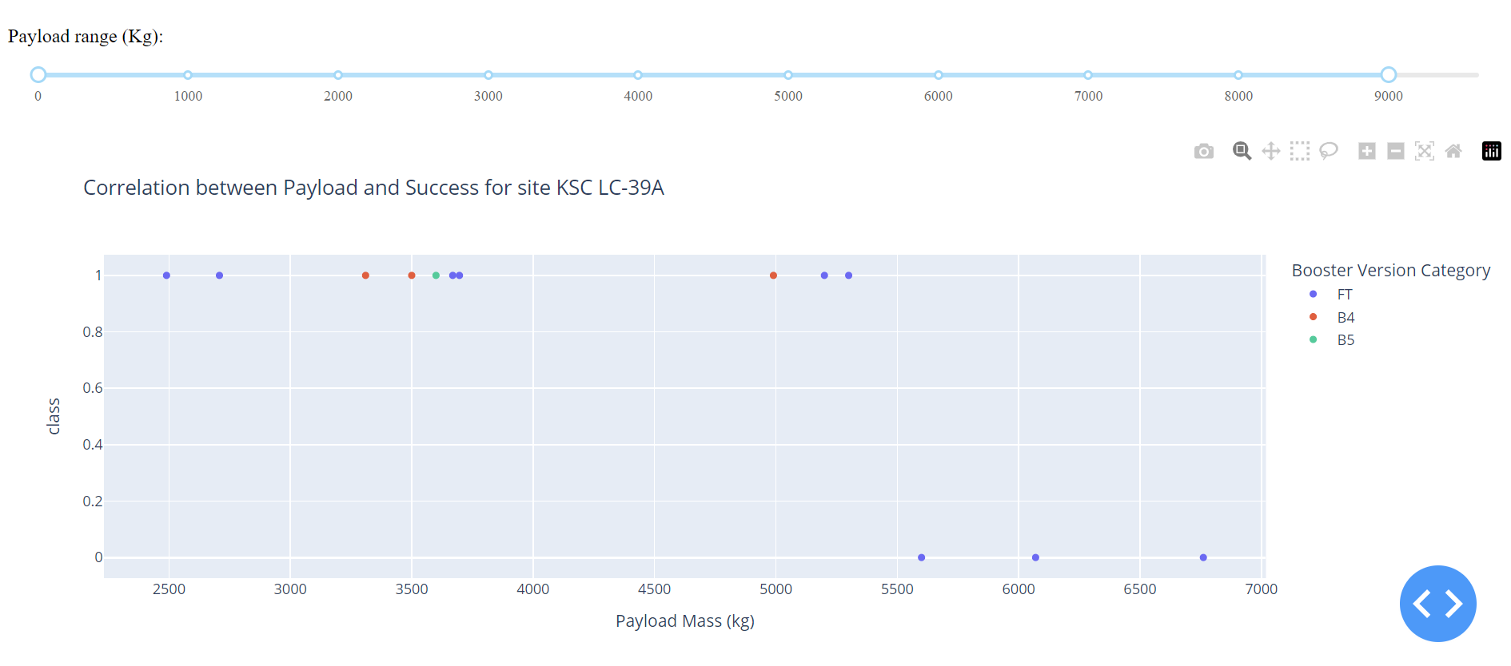
Payload vs. Launch Outcome scatter plot
payload mass range slider at the top allows the user to filter the payloads based on weight, ranging from 0 kg to 9000 kg. In the current view, the graph displays payloads between around 2000 kg and 7000 kg.
The y-axis represents the success rate, where:1: Indicates a successful mission.0: Indicates a failure.

Slide 42

Section 5

Slide 43
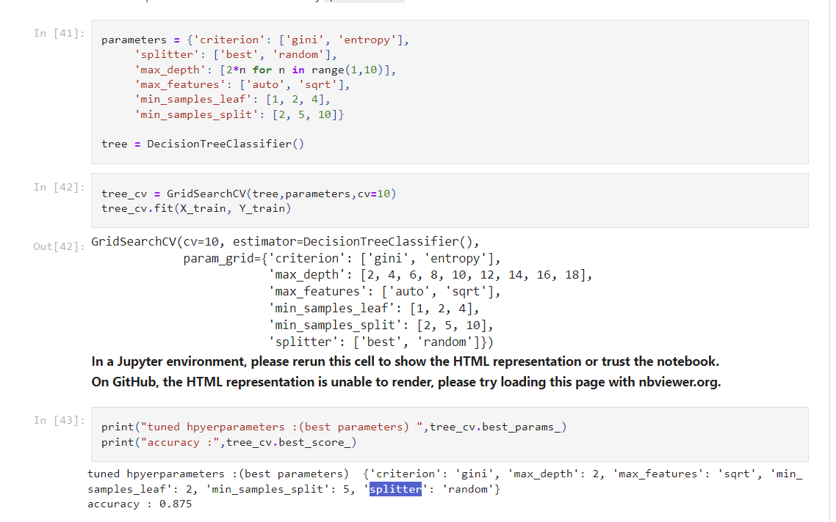
Classification Accuracy
Decision tree classifier that finds the best parameters from the dictionary parameters.

Slide 44
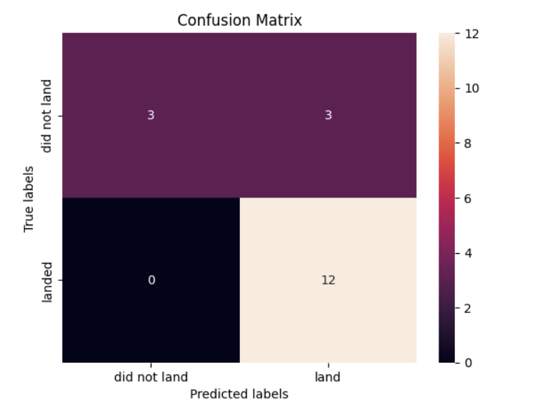
Confusion Matrix
Logistic regression successfully differentiates between the various classes, but the main issue lies in the false positives.
Overview:
True Positive (TP) - 12: The true label is "landed," and the model correctly predicts "landed.“
False Positive (FP) - 3: The true label is "not landed," but the model incorrectly predicts "landed."

Slide 45
Conclusions
Successful Reusability of Boosters: The data shows that SpaceX majority of the launches have been successful, with a significant number of missions having successful booster recoveries on both ground pads and drone ships.
Payload Mass and Landing Success: Analysis revealed a trend where larger payloads tend to have lower success rates.
Importance of Launch Site: Certain launch sites, particularly KSC LC-39A and CCAFS SLC-40, have shown higher success rates.
Predictive Model Performance: Among the machine learning models tested, the Decision Tree classifier showed the highest accuracy in predicting landing success.

Slide 46


